Slide 1

Customer Shopping Behavior Analysis
Uncovering insights from transactional data to guide strategic business decisions.

Slide 2


Project Overview
Analyze Behavior
3,900 Purchases
Guide Decisions
Understand spending patterns, segments, preferences.
Transactional data across various product categories.
Inform strategy for product, marketing, and subscriptions.

Slide 3

Dataset Summary
Key Features
Data Snapshot
Customer demographics (Age, Gender, Location, Subscription)
Rows: 3,900
Purchase details (Item, Category, Amount, Season, Size, Color)
Columns: 18
Shopping behavior (Discount, Promo, Previous Purchases, Frequency, Review, Shipping)
Missing Data: 37 values in Review Rating

Slide 4
Exploratory Data Analysis (Python)
01
02
03
Data Loading & Exploration
Missing Data Handling
Column Standardization
Imported with pandas, checked structure and statistics.
Imputed Review Rating using median by category.
Renamed to snake_case for readability.
04
05
Feature Engineering
Database Integration
Created age_group and purchase_frequency_days.
Loaded cleaned data to PostgreSQL for SQL analysis.

Slide 5

Data Analysis (SQL)
Key Business Questions Answered
Revenue by Gender
Female: $75,191 | Male: $157,890
High-Spending Discount Users
839 customers spent above average with discounts.
Top 5 Products by Rating
Gloves, Sandals, Boots, Hat, Skirt.
Shipping Type Comparison
Express: $60.48 avg. | Standard: $58.46 avg.

Slide 6
SQL Analysis: Subscribers & Discounts
Subscribers vs. Non-Subscribers
Discount-Dependent Products
Yes
1053
$59.49
$62,645
Hat
50.00%
No
2847
$59.87
$170,436
Sneakers
49.66%
Coat
49.07%
Sweater
48.17%
Pants
47.37%

Slide 7



SQL Analysis: Customer Segmentation
New
1
83 Customers
Returning
2
701 Customers
Loyal
3
3116 Customers
Classified customers based on purchase history.

Slide 8

SQL Analysis: Product & Age Insights
Top Products per Category
Revenue by Age Group
Accessories: Jewelry, Sunglasses, Belt
Young Adult: $62,143
Middle-aged: $59,197
Clothing: Blouse, Pants, Shirt
Adult: $55,978
Footwear: Sandals, Shoes, Sneakers
Senior: $55,763
Outerwear: Jacket, Coat

Slide 9
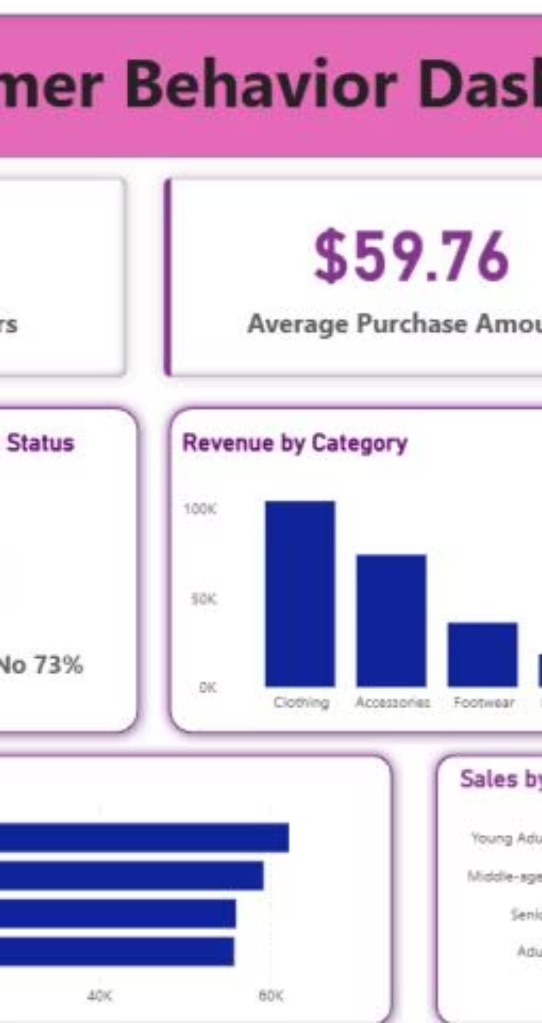



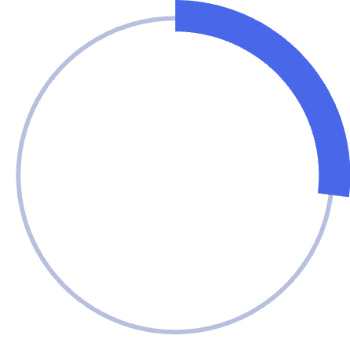
Interactive Dashboard in Power BI
Visualizing key insights for easy understanding.
3.9K
Customers
$59.76
Avg. Purchase
3.75
Avg. Review
27%
Subscribers

Slide 10


Business Recommendations
Boost Subscriptions
Promote exclusive benefits.
Customer Loyalty
Reward repeat buyers.
Review Discount Policy
Balance sales with margins.
Product Positioning
Highlight top-rated items.
Targeted Marketing
Focus on high-revenue groups.

